Slide 1
Shell code analysis

Slide 2
What is Shellcode?
Machine code with a specific purpose.
Spawn a local shell
Bind to port and spawn shell
Create a new account
It can create an interactive command interpreter (shell, for UNIX users) process, or simply issue a single command and return.
Can be executed by the CPU directly –no further assembling/linking or separate compiling required.

Slide 3
How is shell code delivered?
Part of an exploit
Size of Shellcode important (smaller size=better)
Bad characters a concern
0x00 most come one.
Added into an executable
Run as separate thread
Replace executable functionality
Size of shell code not a concern

Slide 4
Shell code resources
https://shell-storm.org/shellcode/index.html
https://www.exploit-db.com/shellcodes
Notes:
https://shell-storm.org/shellcode/files/shellcode-806.html

Slide 5
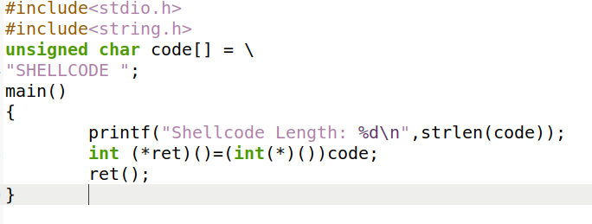
Testing Shellcode
Notes:
https://shell-storm.org/shellcode/files/shellcode-806.html

Slide 6
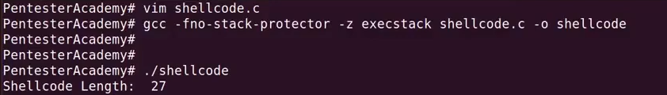
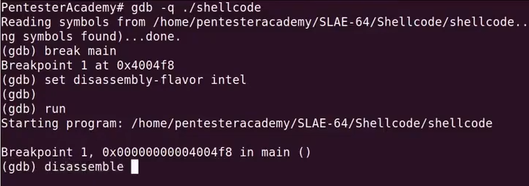
Executing shell code

Slide 7
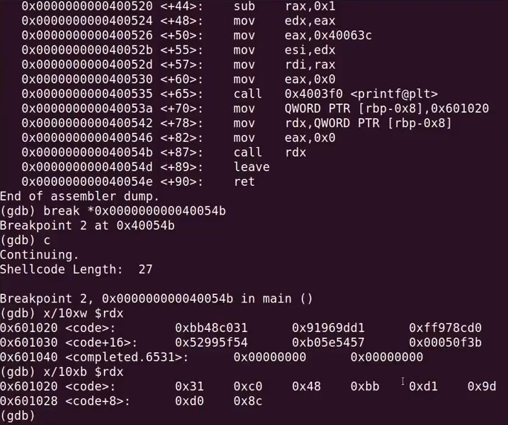

Slide 8
